Slide 1


MINOR PROJECT
Detecting Ripeness Of Fruits using Machine Learning
Presented By:
R2142201580- Ayush Goel
R2142201811- Kalpana Srivastava
R2142201666- Md Saif Anjum Khan
R2142201690- Yachika Maheshwari
Mentor- Dr. Ambika Aggarwal

Slide 2
Content
Introduction
Result
Conclusion
Reference

Slide 3
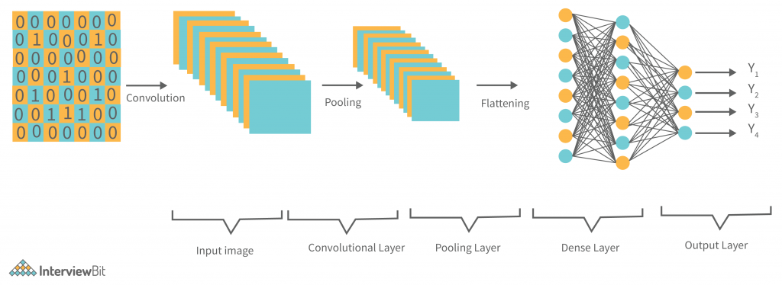
Introduction
Technical Background
CNN Architecture

Slide 4
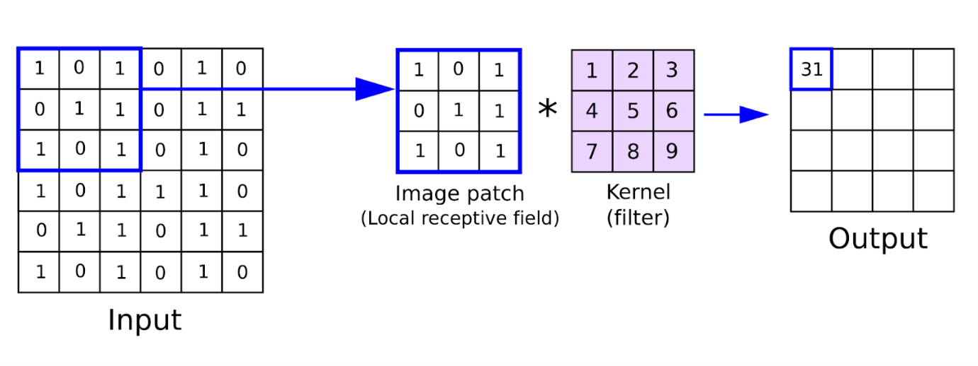
Introduction
Convolution Layer

Slide 5
Introduction
Pooling Layer
There are different types of Pooling, some of them are:
Max Pooling
Mean Pooling
Sum Pooling
In our model we have used Max Pooling.

Slide 6
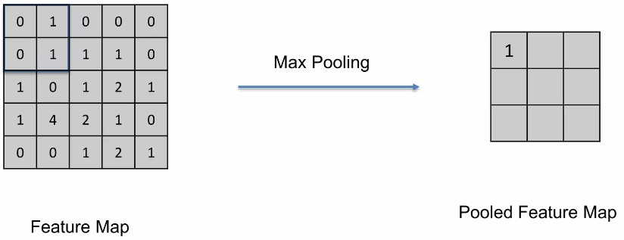
Introduction
Max Pooling

Slide 7
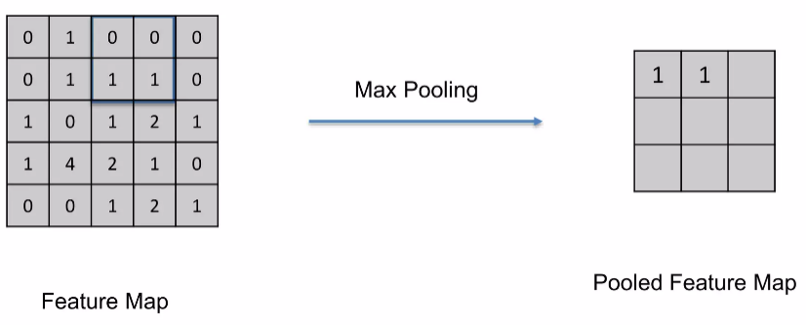
Introduction
Max Pooling

Slide 8
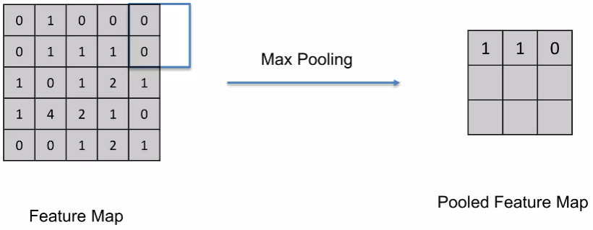
Introduction
Max Pooling

Slide 9
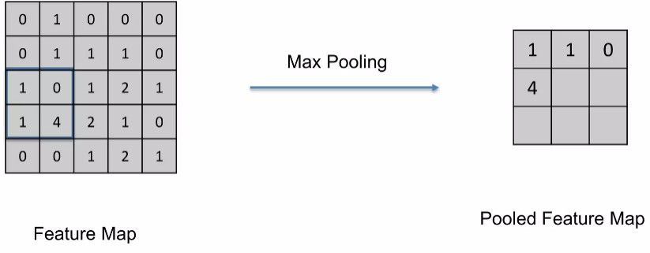
Introduction
Max Pooling

Slide 10
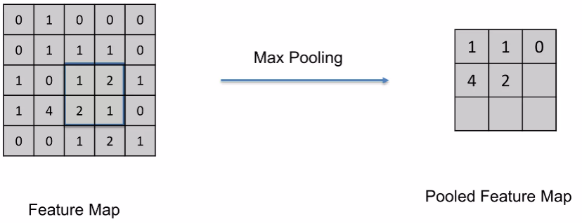
Introduction
Max Pooling

Slide 11
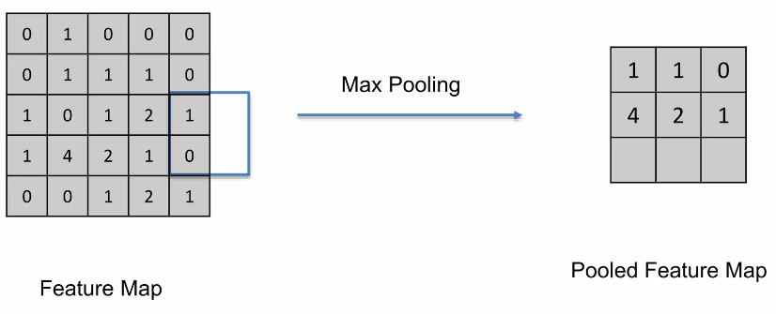
Introduction
Max Pooling

Slide 12
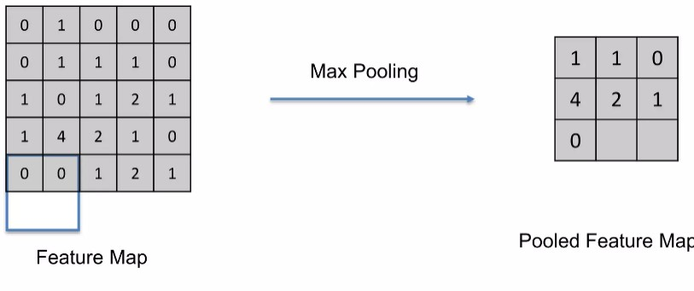
Introduction
Max Pooling

Slide 13
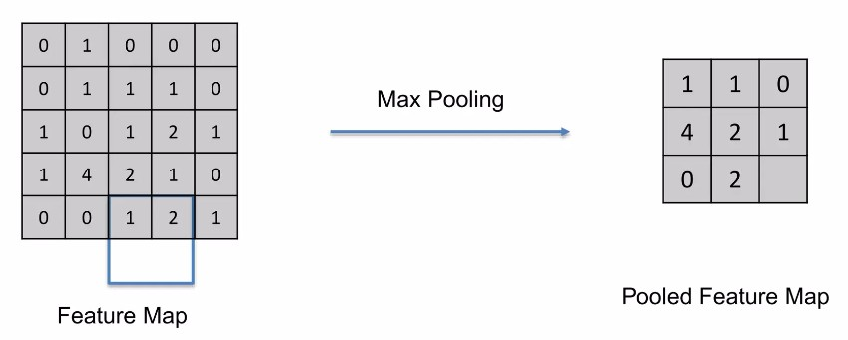
Introduction
Max Pooling

Slide 14
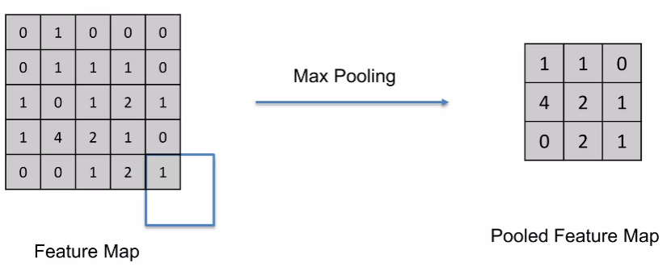
Introduction
Max Pooling

Slide 15
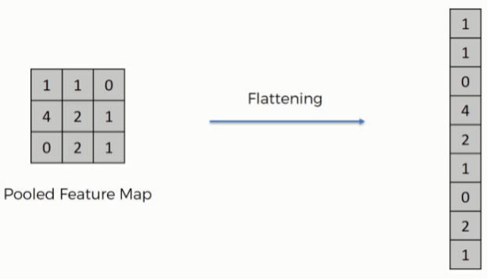
Introduction
Flattening Layer

Slide 16
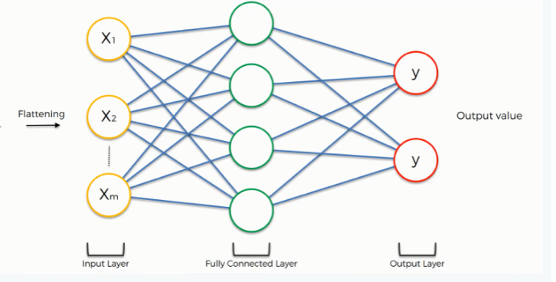
Introduction
Full Connection

Slide 17
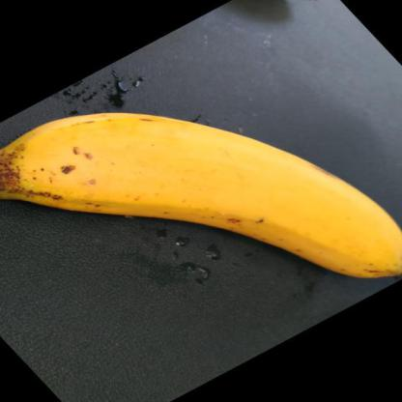

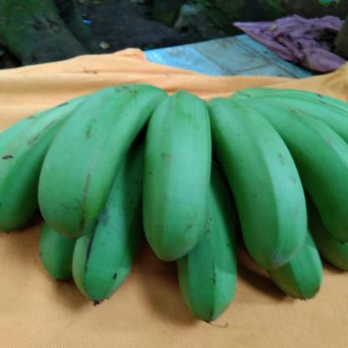
Results
Tests Cases
Ripe
Unripe

Slide 18
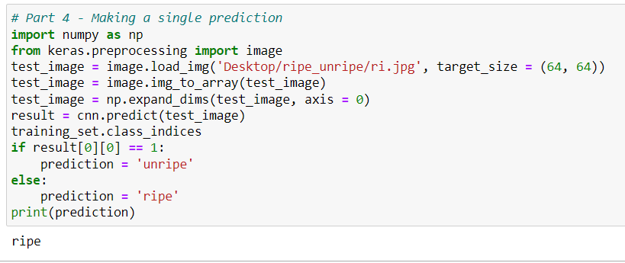
Results
Tests Cases

Slide 19
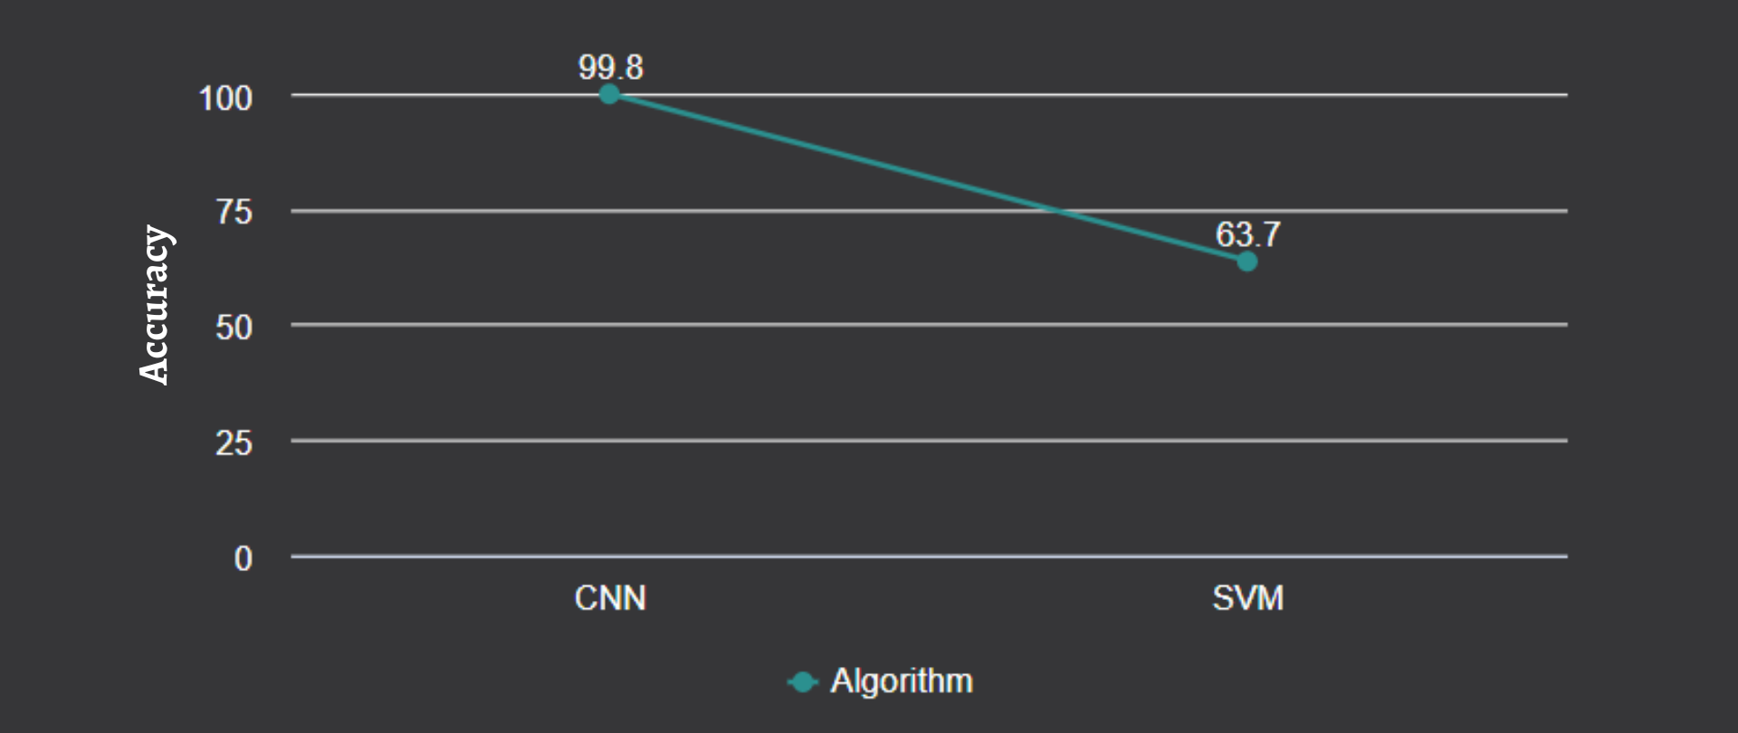
Results
Outcome Graph

Slide 20
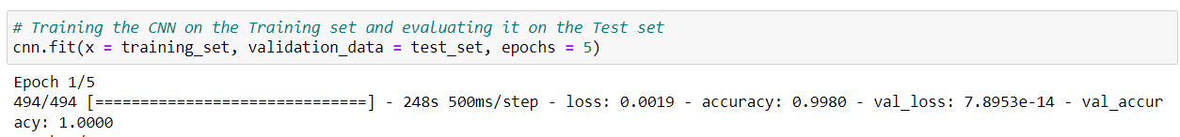
Results
Comparative Study
CNN (Convolutional Neural Network)

Slide 21
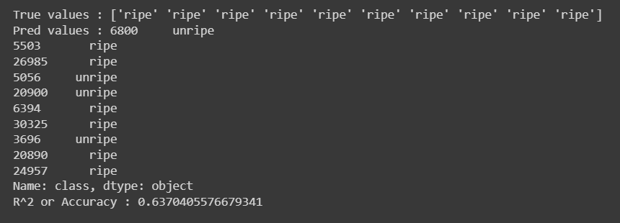
Results
Comparative Study
SVM (Support Vector Machine)

Slide 22

Conclusion
Justification of Objectives
The Objective Justification is done on the basis of SMART (Specific, Measurable, Achievable, Relevant, Timebound).
Specific: The system intended to classify Ripe and Unripe fruits. Ripeness and un-ripeness specifies the maturity level of a fruit.
The user can feed the image of the desired fruit and the model will process the image to classify weather the fruit is ripe or unripe.

Slide 23


Conclusion
Justification of Objectives
Measurable: The user must upload the image in accordance with the system's requirements. High resolution images will provide greater accuracy. The user can also upload low-resolution images, but the accuracy will be compromised to some extent.
Achievable: The admin has database access and will manage the system. Anyone can use it without restriction, but they cannot modify the system's code. It will be accessible 24 X 7.

Slide 24


Conclusion
Justification of Objectives
Relevant: Regular system maintenance will be performed by adding updates and upgrades to ensure the system's smooth operation on the user end.
Timebound: Our project took three months to complete. We will include monthly updates in the future to maintain system performance and provide a better user experience.

Slide 25
Conclusion
Future Scope
In the future, we will apply our model to the recognition of more fruit, and improve the network’s general usability. Also, by using GPU, we can reduce the time of training of dataset features. Same model can be applied for any kind of dataset regarding to other fruit ripeness stages classification.
The simplicity, the high recognition rate, and the speed of the classification model, make it appropriate for implementing a productive and profitable computer vision machine for the food processing industry in future.

Slide 26
Conclusion
Future Scope
In Future, we can use Artificial Neural Network (ANN) algorithm that can be used for classifying the diseases and pattern matching caused from more ripened fruit. This technique reduces the effort of humans and can give 90% accurate results. The future work is to suggest proper treatments accordingly once the disease is detected.

Slide 27
Thank You

